Slide 1
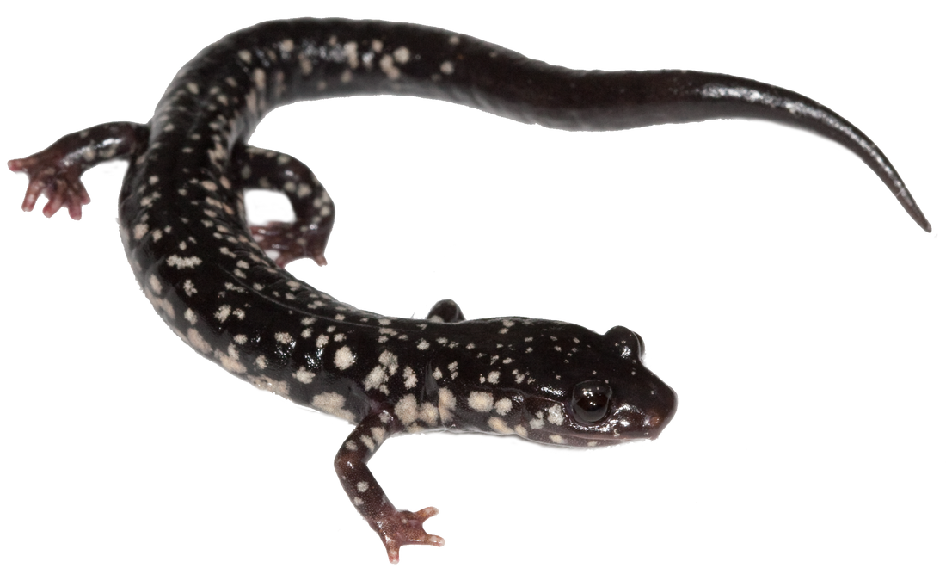
Evolutionary Transitions of a Discrete Trait
LunchinatoRs
April 6, 2018
Erica Baken

Slide 2
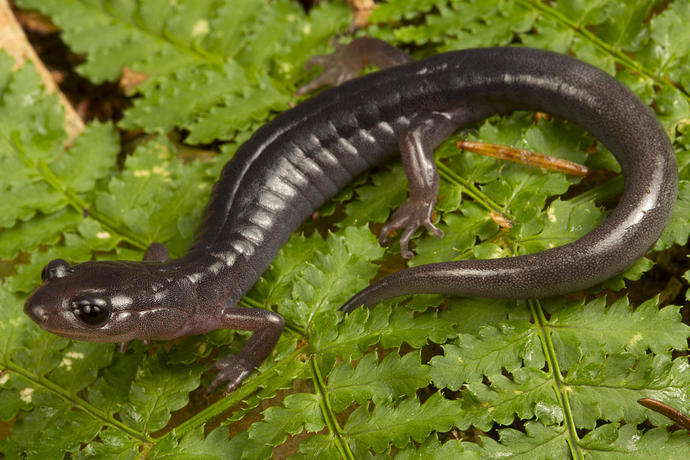
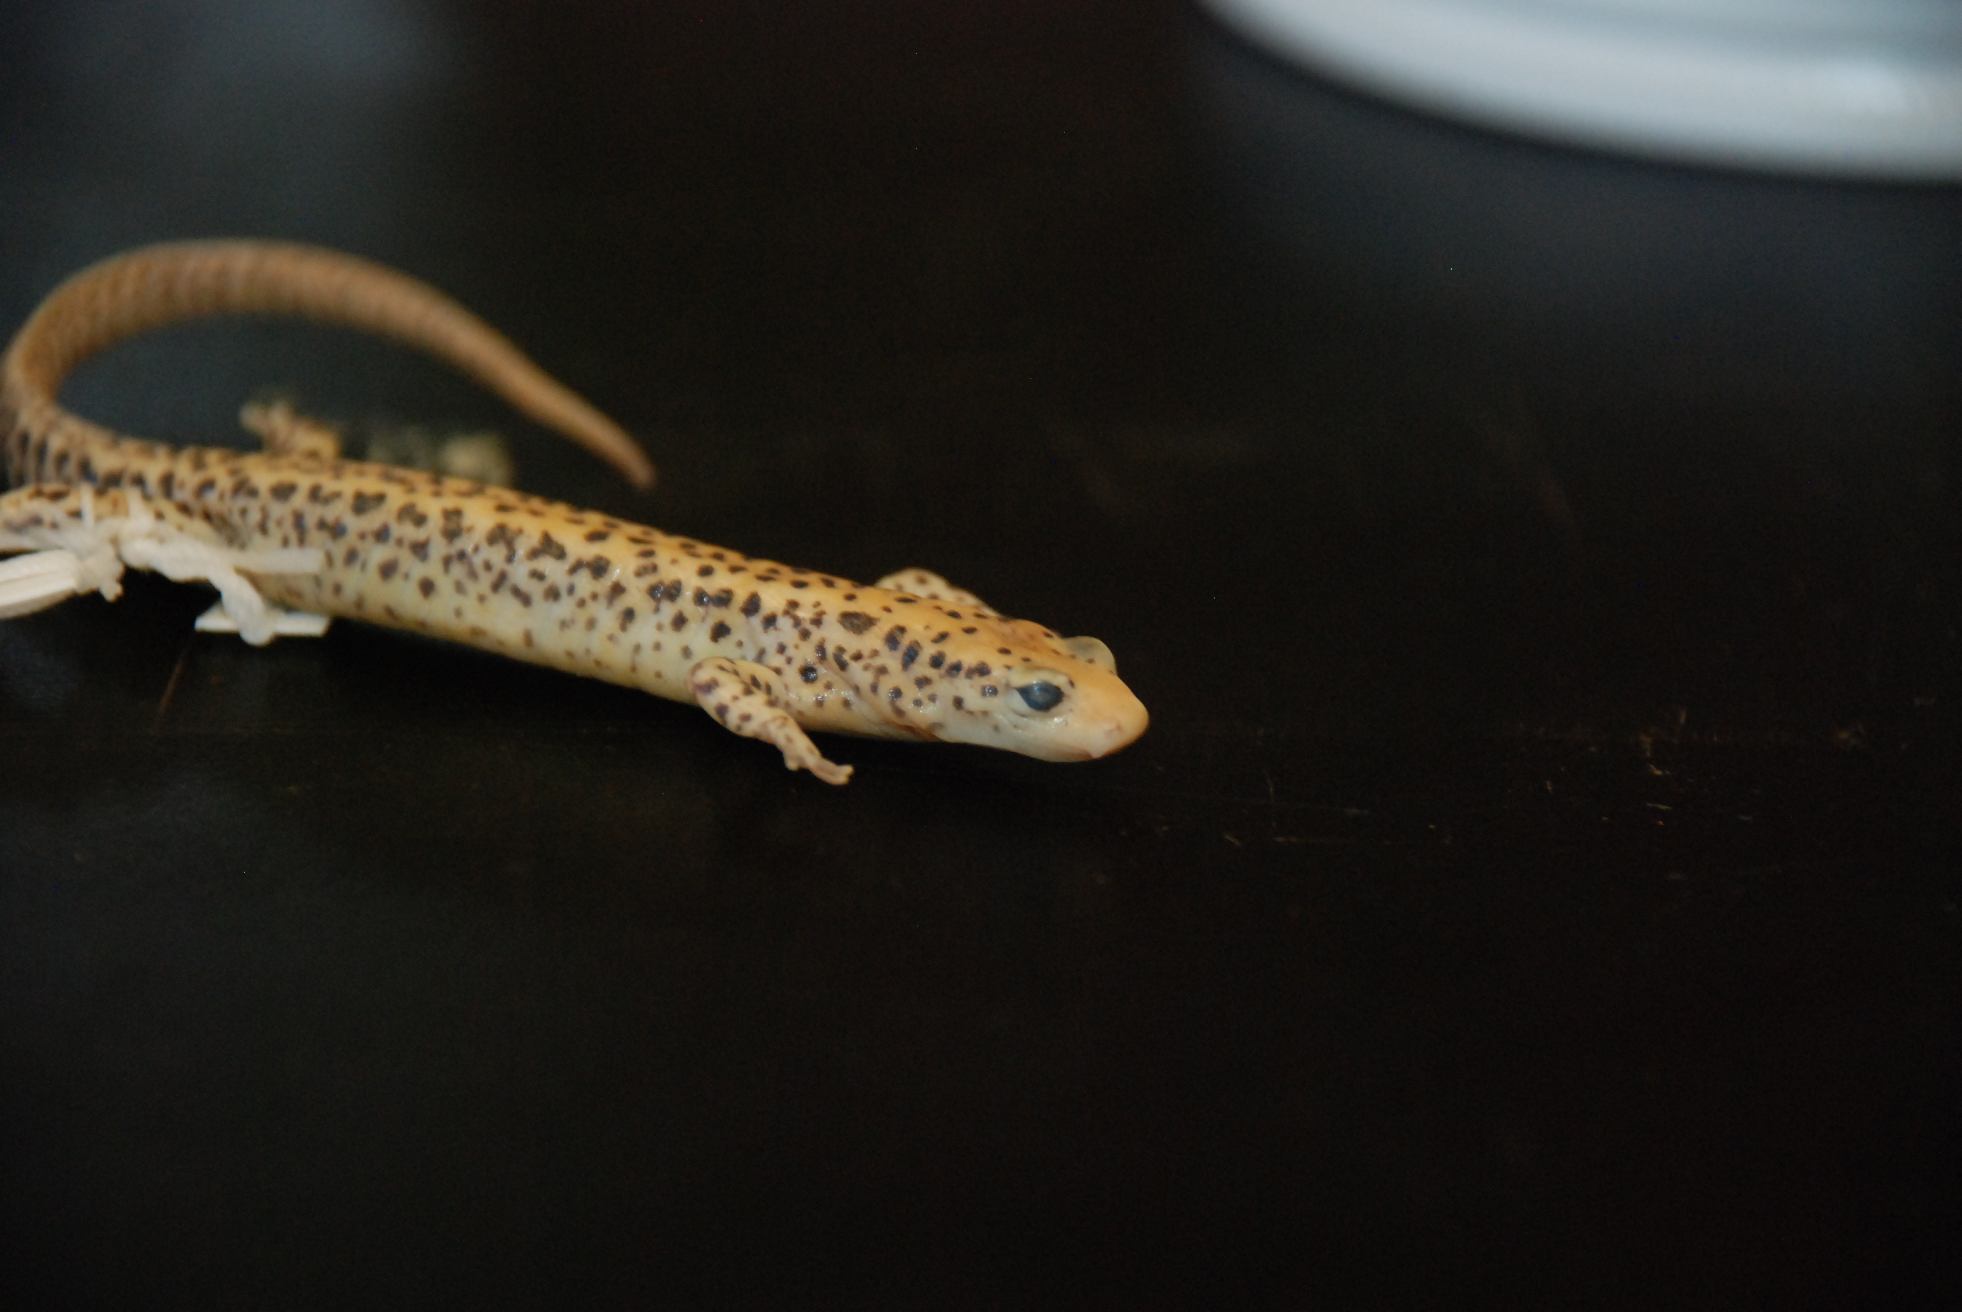
Main Question
How does a salamander become arboreal?
How many times has it happened?
Are there eco-evolutionary limitations to these transitions?
Which types of salamanders have done it?

Slide 3
Many methods for this type of question
Parsimony 😐
Ancestral State Estimation
Maximum Likelihood – ape package
Majority Rule
Stochastic Mapping
Simulation Based – simmap package
Single Rate Matrix
Reverse Jump MCMC
BayesTraits – through terminal
Hidden Markov Model
Model Comparison – corHMM package
Multiple Rate Matrix Regimes
Raw Number of Transitions
Rate of Transitions

Slide 4

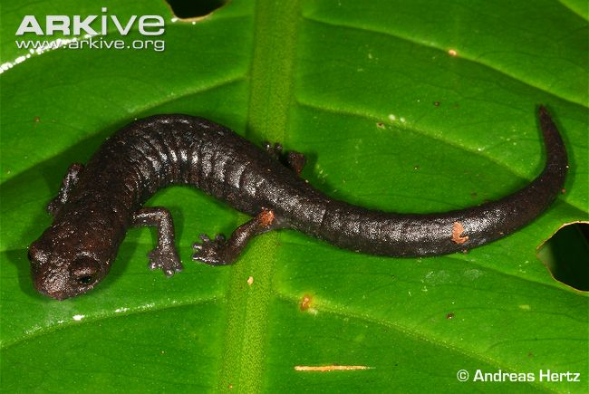
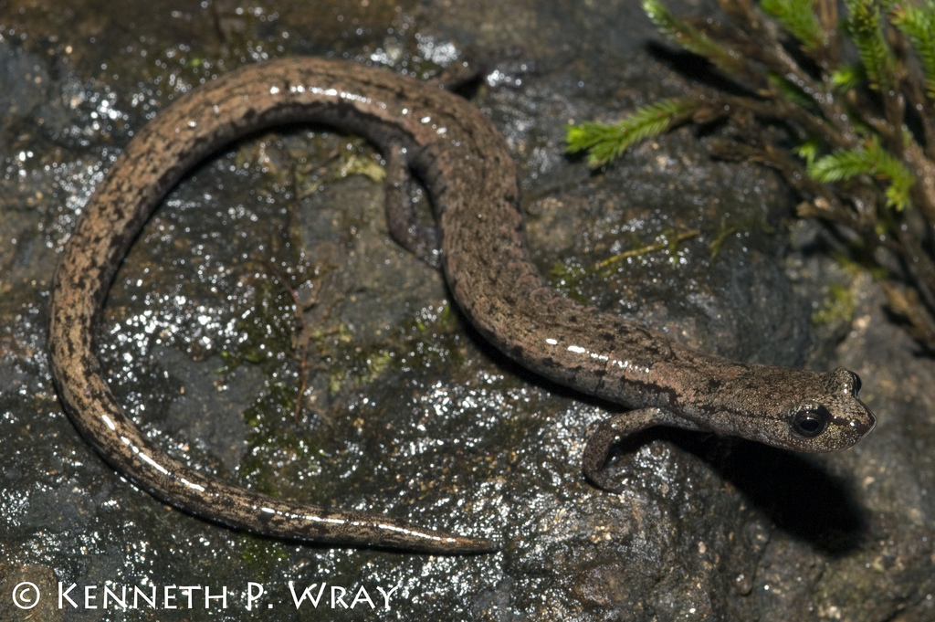
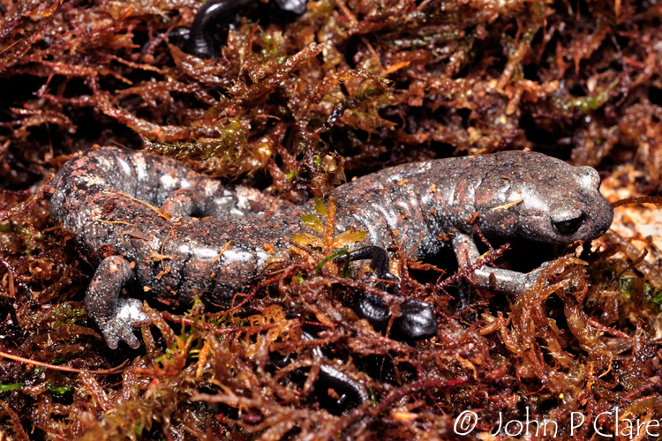

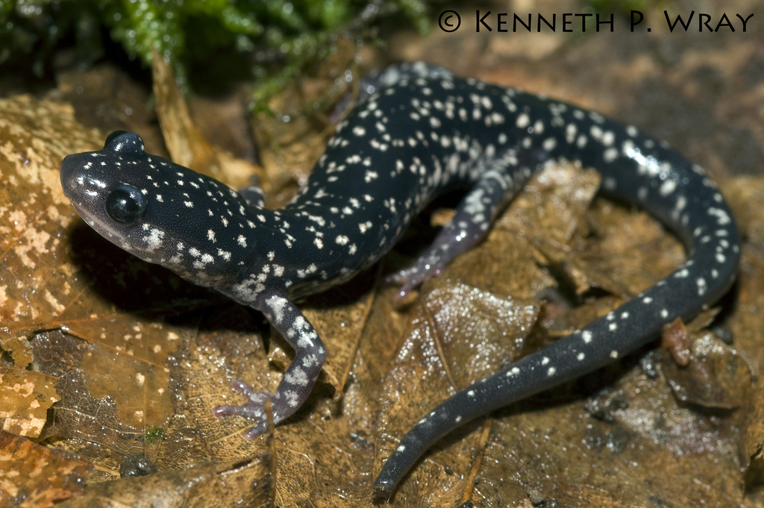
Notes:
Bolitoglossa sombra – arboreal
Batrachoseps stebbinsi – saxicolous
Aquiloeurycea galeanae – terrestrial
Plethodon kentucki – fossorial
Eurycea nana– aquatic

Slide 6
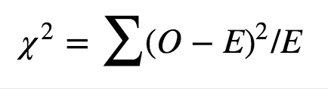
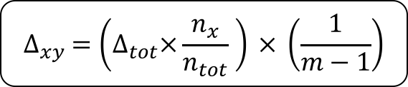
$$∆_{xy} =\left(∆_{tot}×\frac{n_{x}}{n_{tot}} \right) × \left(\frac{1}{m−1}\right)$$
Observed
 | A | F | S | T | Aq
A |  | 0 | 1.80 | 7.07 | 0
F | 0 |  | 0.12 | 0.92 | 0
S | 0 | 2.37 |  | 1.18 | 0.18
T | 29.85 | 19.00 | 15.81 |  | 7.17
Aq | 0 | 1.00 | 2.00 | 1.86
NULL
 | A | F | S | T | Aq
A |  | 3.81 | 3.81 | 3.81 | 3.81
F | 1.97 |  | 1.97 | 1.97 | 1.97
S | 2.25 | 2.25 |  | 2.25 | 2.25
T | 11.63 | 11.63 | 11.63 |  | 11.63
Aq | 2.92 | 2.92 | 2.92 | 2.92
Notes:
So the expected number of transitions is taking the total number of observed transitions and weighting it by the number of species that represent each microhabitat. An equal number of species in each habitat would have given us the same number of transitions in each box, but since there are lots more terrestrial species, we would expect the raw number of transitions from the terrestrial state outward to be higher simply because they represent more species.

Slide 7
Observed
 | A | F | S | T | Aq
A |  | 0 | 1.80 | 7.07 | 0
F | 0 |  | 0.12 | 0.92 | 0
S | 0 | 2.37 |  | 1.18 | 0.18
T | 29.85 | 19.00 | 15.81 |  | 7.17
Aq | 0 | 1.00 | 2.00 | 1.86
NULL
 | A | F | S | T | Aq
A |  | 3.81 | 3.81 | 3.81 | 3.81
F | 1.97 |  | 1.97 | 1.97 | 1.97
S | 2.25 | 2.25 |  | 2.25 | 2.25
T | 11.63 | 11.63 | 11.63 |  | 11.63
Aq | 2.92 | 2.92 | 2.92 | 2.92
Overall: p < 0.001*
TO Arb: p < 0.001*
FROM Arb: p = 0.009*
Notes:
Those are the tests I can make. So again, we can either chat about that null expected equation or I can show you how I implemented it in r very simply…

Slide 8
Stochastic Mapping
 | A | F | S | T | Aq
A |  | 0 | 1.91 | 23.04 | 0
F | 0 |  | 12.00 | 8.25 | 0
S | 0.30 | 10.92 |  | 5.71 | 2.44
T | 32.85 | 16.87 | 15.31 |  | 7.81
Aq | 0 | 0 | 4.71 | 2.11
Majority Rule
 | A | F | S | T | Aq
A |  | 0 | 1.80 | 7.07 | 0
F | 0 |  | 0.12 | 0.92 | 0
S | 0 | 2.37 |  | 1.18 | 0.18
T | 29.85 | 19.00 | 15.81 |  | 7.17
Aq | 0 | 1.00 | 2.00 | 1.86
NULL
 | A | F | S | T | Aq
A |  | 6.08 | 6.08 | 6.08 | 6.08
F | 3.15 |  | 3.15 | 3.15 | 3.15
S | 3.58 | 3.58 |  | 3.58 | 3.58
T | 18.57 | 18.57 | 18.57 |  | 18.57
Aq | 4.67 | 4.67 | 4.67 | 4.67
NULL
 | A | F | S | T | Aq
A |  | 3.81 | 3.81 | 3.81 | 3.81
F | 1.97 |  | 1.97 | 1.97 | 1.97
S | 2.25 | 2.25 |  | 2.25 | 2.25
T | 11.63 | 11.63 | 11.63 |  | 11.63
Aq | 2.92 | 2.92 | 2.92 | 2.92

